Slide 1




Global Coffee Source
By: Anusha Valasapalli
Jeevan Hall

Slide 2

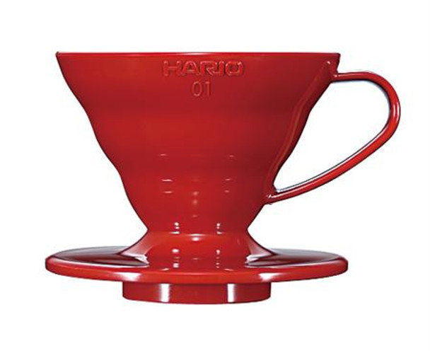
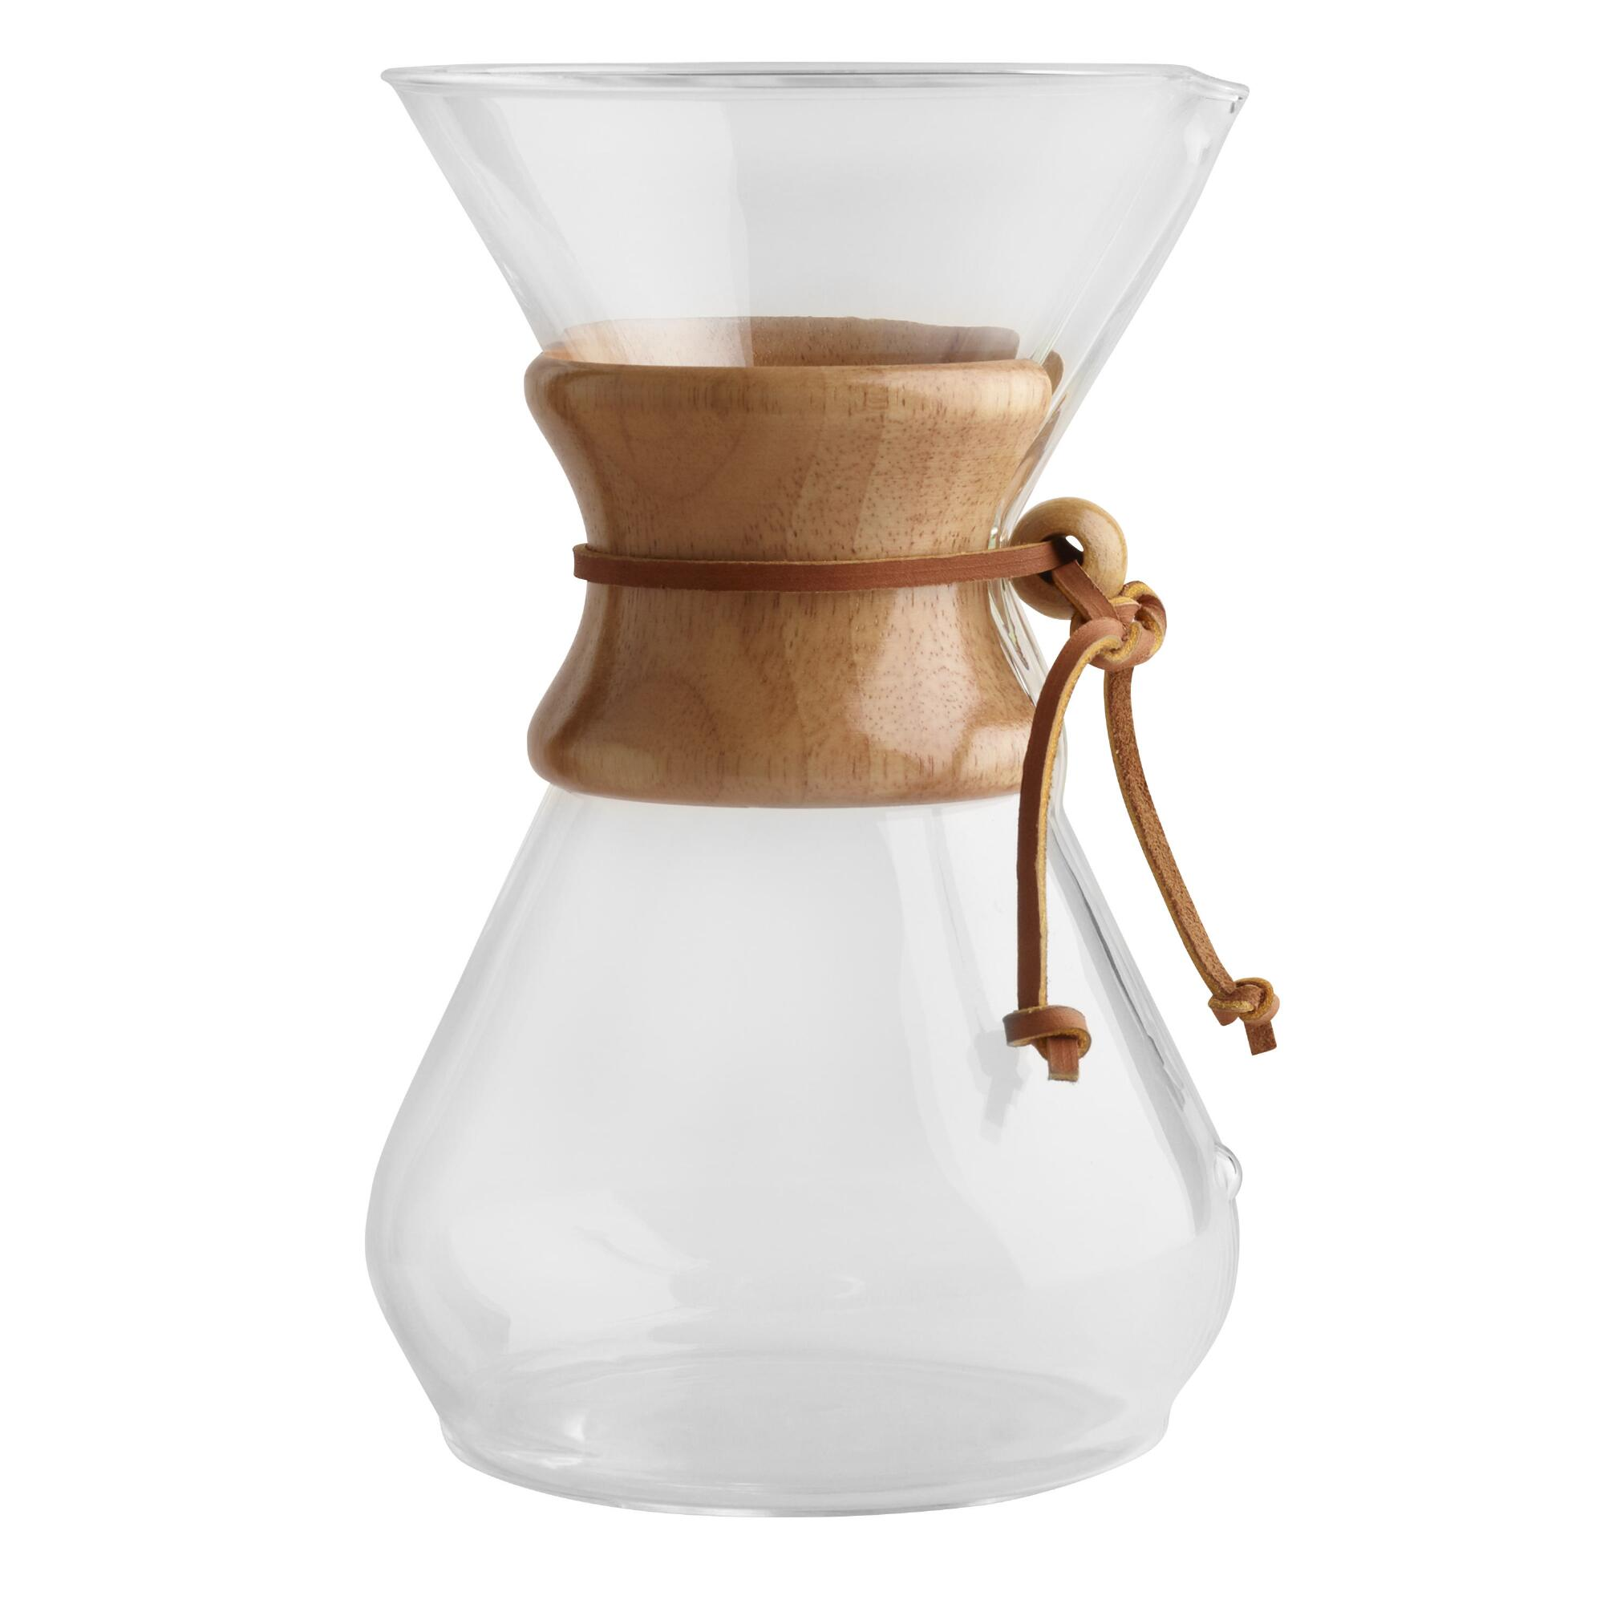
Agenda
Introduction
Business Value
Responsive Design
Content
Website Demo

Slide 3
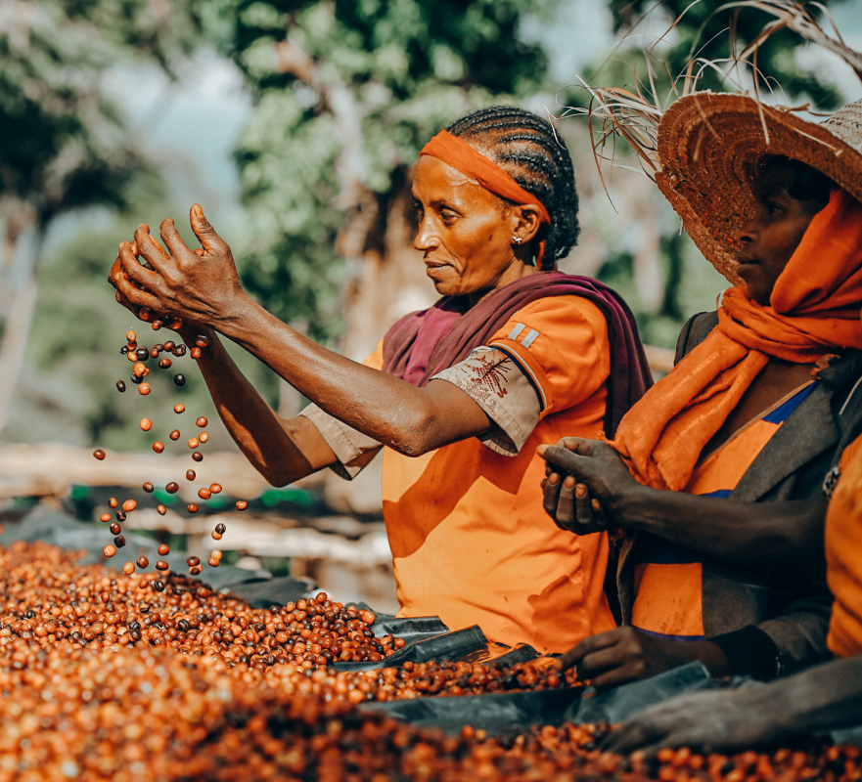
Why Coffee?
The world's coffee production occurs in tropical regions near the equator. This region between the tropic of Cancer and the tropic of Capricorn is known as the coffee belt.
The Arabica species directly affects the human sensory experience more significantly than Robusta. Robusta coffee features a less potent and more bitter taste. Robusta covers only 35% of world production, while Arabica covers 64%.

Slide 4
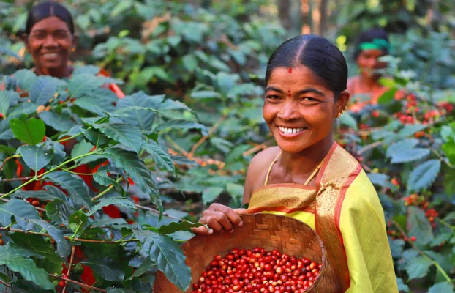
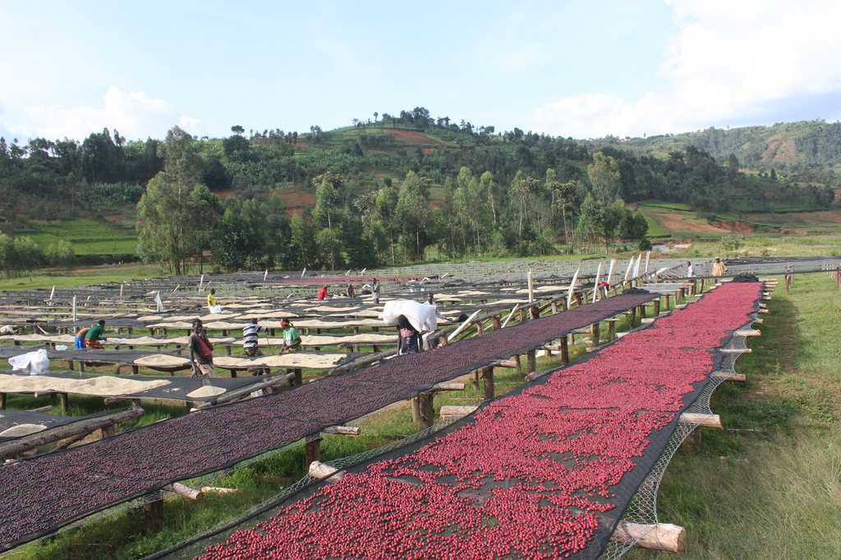
Business Value
Providing Local Coffee Farmers w/ a Global Platform –
Helping Farmers while Promoting Awareness to LA residents

Slide 5
Measurable Organizational Value
Promoting Global Coffee Culture
Helping Farmers
We want to raise awareness about different coffee beans across the globe. Coffee is like wine in that it has many different flavors and textures.
We will address coffee processing methodology and develop relevant access to coffee for everyday people regardless of income.
Global coffee source aims to provide a standardized measurement of quality coffee across the globe while promoting market accessibility for local coffee farmers while linking them with consumers.

Slide 6














Responsive Design
Multiple Displays
Flexible, Multi-Platform
iPhone
Android
Samsung Galaxy Tab
PC Display
4K Television
WINDOWS
LINUX (UBUNTU, REDHAT)
MAC OS
API/Tools
HTML/CSS/JS
BOOTSTRAP
FIREBASE
SUPABASE
JQUERY LIBRARY
AJAX
Global Coffee Source Website - Responsive Design

Slide 7
Content Focus
Video/Image Content
JS Functionality
Embedded YouTube
Farmers
Farms
Coffee Beans
Products
Search
Add to cart
Remove from Cart
Customer Contact Info
Products submit
Global Coffee Source Website - Responsive Design

Slide 8
SUMMARY
This Website is specifically designed to be helpful for communication between global farmers and Coffee Shops.
Farmers from different countries will approach this website to sell their Coffee beans and other products and appliances to prepare coffee.
Farmers or Local shops interested in buying or selling their products must fill out the contact form. The website management team will communicate with interested customers and set up a meeting with coffee farmers and coffee buyers.

Slide 9
Demo
https://anushavalasapalli-97.github.io/GLOBAL_COFFEE_SOURCE/dist/home.html

Slide 10


